Slide 1
Forestry Equipment Identification for the
National Forestry CDE
Developed by:
Lynn Barber &
Jim Galvin
Computer Workshop, 6/27/02

Slide 2
Objectives
Students will be able to:
Identify all equipment on the National Forestry CDE list.
Describe the use of each piece of equipment.

Slide 3
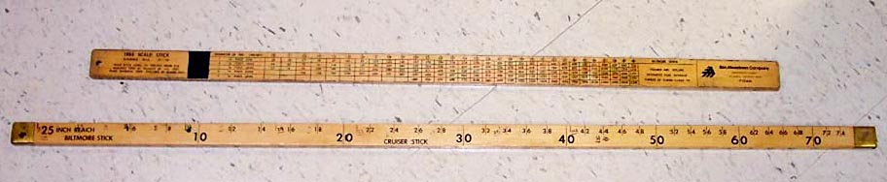
Tree Stick
Tree sticks (commonly called Biltmore Sticks) are used to estimate tree heights and diameters. Most include a log scale that can be used for volume estimation.

Slide 4
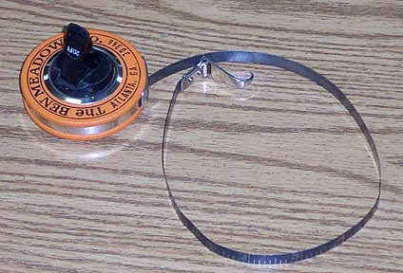
Diameter Tape
This tape is based on the relationship of circumference to diameter and is used for measuring the diameter of trees directly

Slide 5
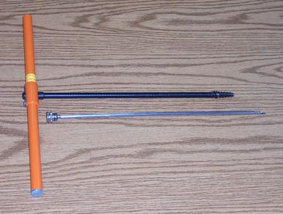
Increment Borer
This tool is used to extract cores from trees for the determination of growth and age

Slide 6
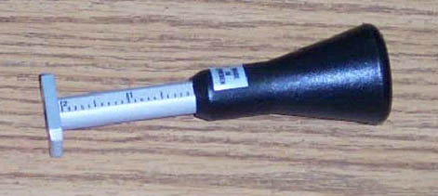
Bark Gauge
Used to determine the thickness of the bark on trees.

Slide 7
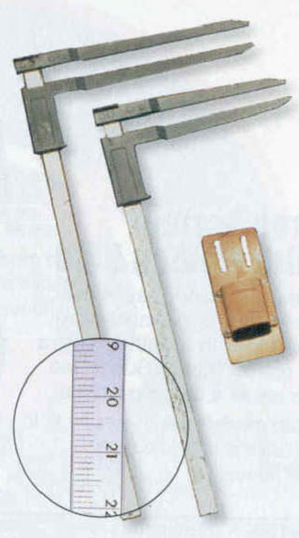
Tree Caliper
Used to quickly measure tree diameter.

Slide 8
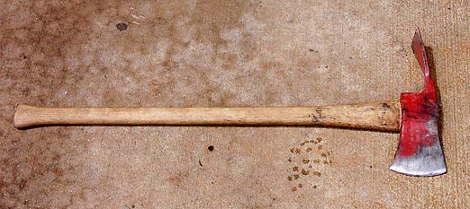
Pulaski Forester Axe
Commonly used by firefighters to remove brush and clear areas of debris

Slide 9
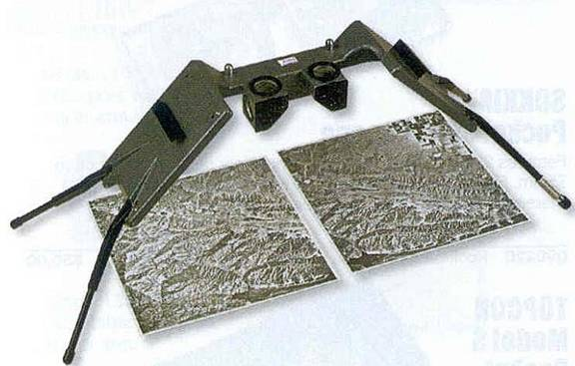
Stereoscope
A magnifying system designed for viewing arial photographs

Slide 10
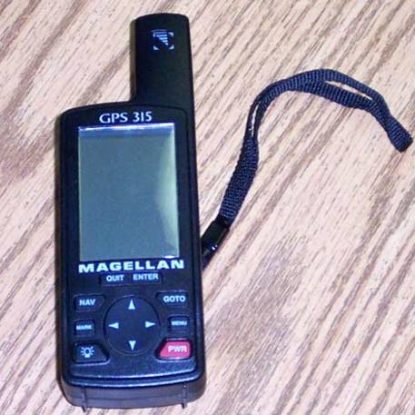
GPS Receiver
GPS units come in a variety of brands and styles.
Their primary purposes include navigation and mapping.

Slide 11
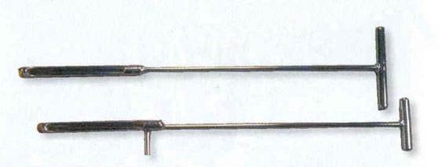
Soil Sampler
A hand tool used for collecting soil samples up to a depth of ~12”

Slide 12
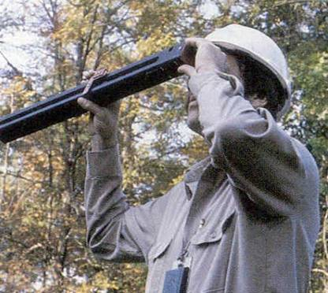
Wheeler Caliper
This visual instrument measures tree diameter. It measures at any height on the tree stump, diameter at breast high, 4-1/2 feet (dbh), or merchantable height. No baseline distance measurement needed. The instrument establishes parallel lines of the sight. One line of the sight is stationary, the other side is moveable.

Slide 13
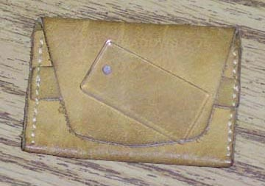
Wedge Prism
Consists of a thin wedge of glass that fends light rays as they pass through it.
Used to determine the number of trees that should be counted when determining basal area of a stand.

Slide 14
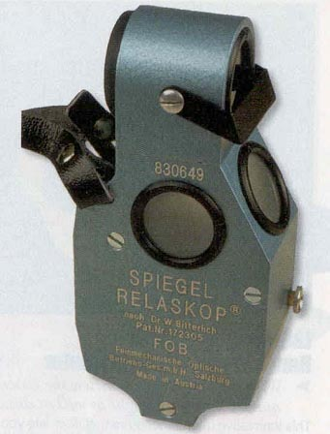
Relaskop
Measuring instrument that can be used for:
Rangefinding
Clinometer
Dendrometer
Angle Gauge
Slope Correction

Slide 15
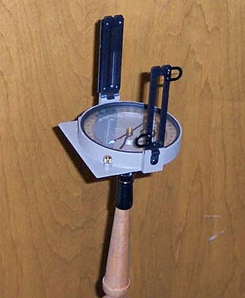
Staff Compass
This compass is placed on a Jacob staff for added stability. It is more accurate than a hand compass.

Slide 16
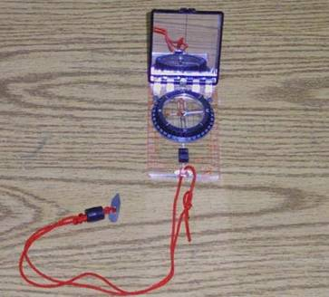
Hand Compass
An instrument used to determine direction.
Useful for navigation and mapping

Slide 17
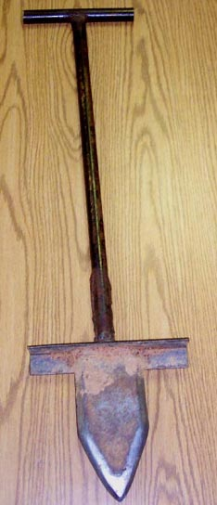
Planting Bar
Used to make a slit-hole in the soil where a tree can be planted.

Slide 18
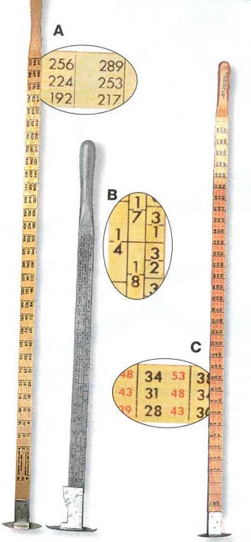
Log Rule
Used to determine lumber content of felled logs.

Slide 19
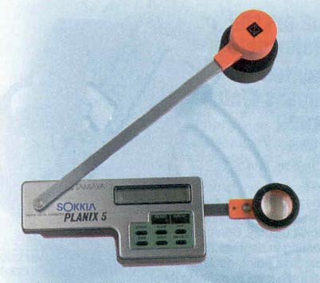
Planimeter
Precise instruments for fast, accurate determination of areas from blueprints, maps, and photos.

Slide 20
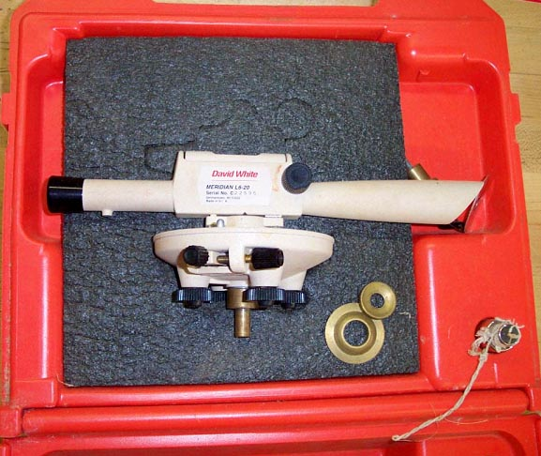
Survey Instrument
(level)

Slide 21
Survey Instrument
Survey instruments include levels and transits.
They are commonly used to map sites and estimate sloping.

Slide 22
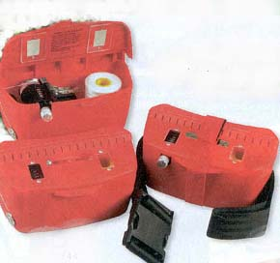
Hip Chain
Designed to fit on the belt for hands-free work. Can measure distances over rough terrain. Can measure distances up to 6000’

Slide 23
Plastic Flagging
Useful for marking points, trails, roads, etc.

Slide 24
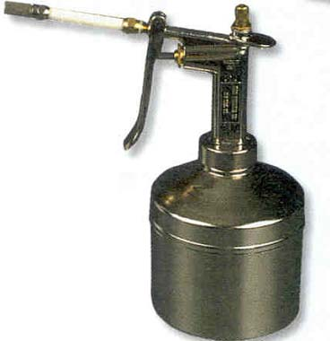
Tree Marking Gun
This tool can be filled with paint to easily mark standing trees.

Slide 25
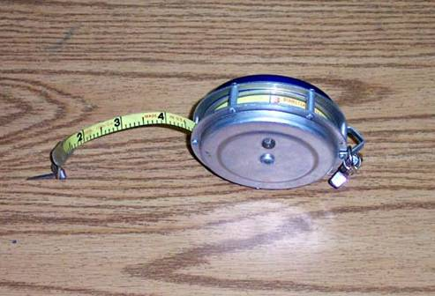
Logger’s Tape
These tapes can be used for a variety of tasks including:
Measuring diameter
Measuring felled trees
Measuring distance from tree (usually up to 100’

Slide 26
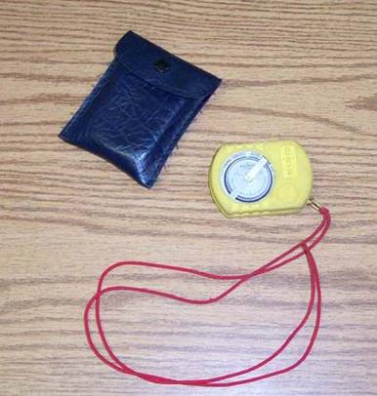
Clinometer
Used for measuring vertical angles and slopes.
Commonly used by foresters to estimate tree height.

Slide 27
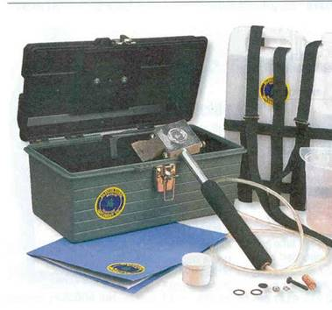
Hypo-Hatchet
A tool used to inject herbicides into trees.

Slide 28
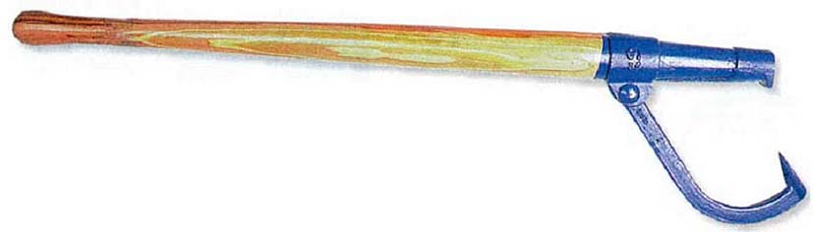
Canthook
Designed to roll and maneuver logs.

Slide 29
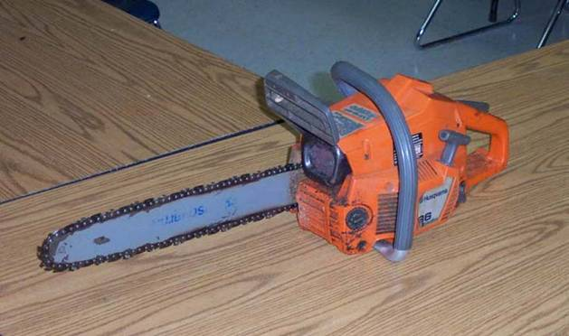
Chainsaw

Slide 30
Chainsaw
Come in a variety of sizes and types.
Used for felling trees, delimbing, brush clearing, etc.

Slide 31
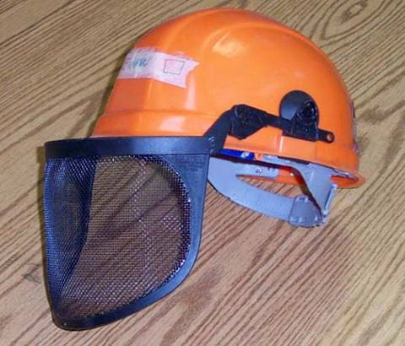
Safety Hard Hat
Safety helmets protect the head from injury by falling objects such as tree limbs.
Many helmets include accessories such as eye and hearing protection.

Slide 32
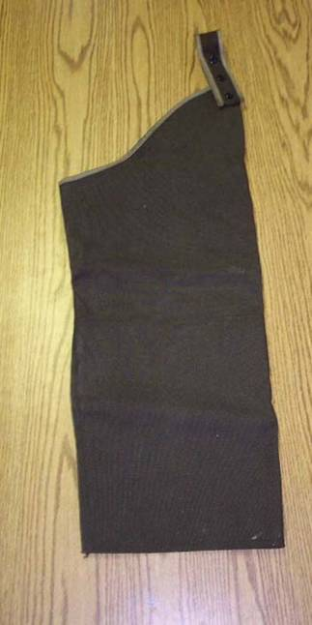
Chainsaw Chaps
Used as an aid in preventing injuries to the legs from chainsaw cuts.

Slide 33
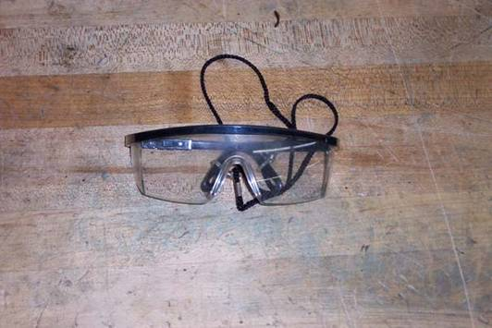
Safety Glasses
Protects the eyes. Should be worn in all situations where there is danger of small objects flying in the eye.

Slide 34
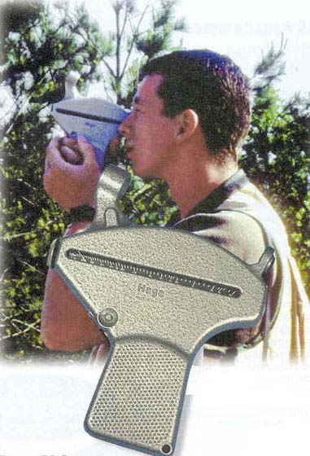
Altimeter
Used to determine height and slope measurements

Slide 35
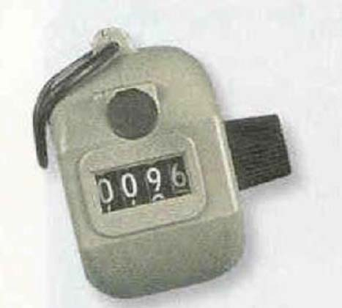
Tally Meter
Can be used for counts of standing trees or counting logs.

Slide 36
Fiberglass Measuring Tape
Comes in a variety of styles and lengths. Useful for measuring distances up to 300’.

Slide 37
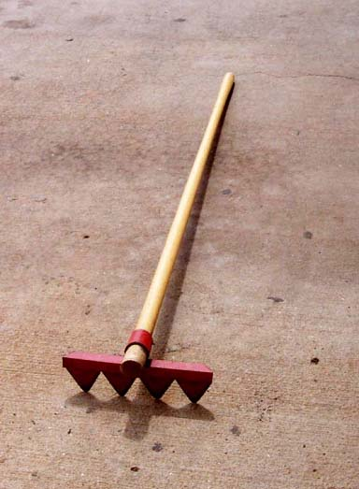
Fire Rake
Useful for removing fuel from the path of a fire.

Slide 38
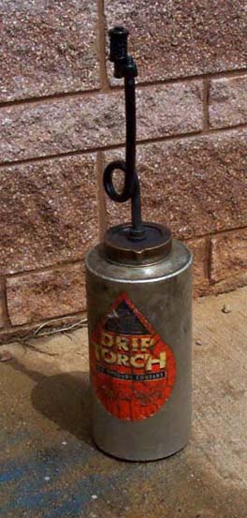
Drip Torch
Useful for setting fires for controlled and prescribed burns.

Slide 39
Data Recorder
Used to record field data from cruises, agricultural research, and surveys.

Slide 40
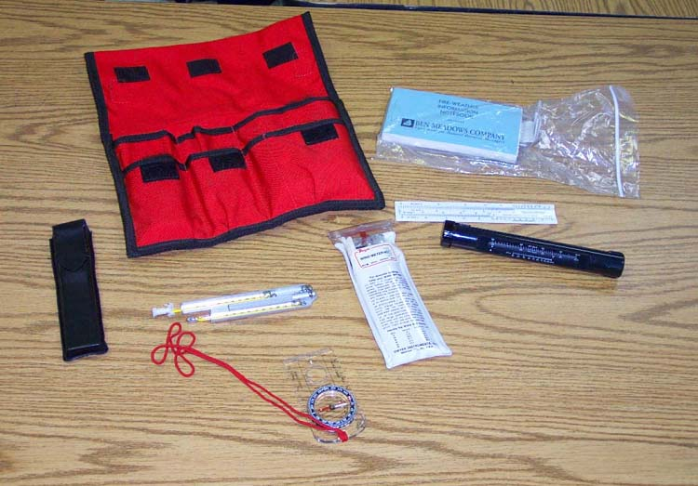
Fire Weather Kit

Slide 41
Fire Weather Kit
This kit includes a number of things the forester would use to determine if conditions are favorable for burning.
Items include: sling psychrometer, hand compass, wind meter, information notebook, etc.

Slide 42
Tally Book
Used to record field data from timber cruises.

Slide 43
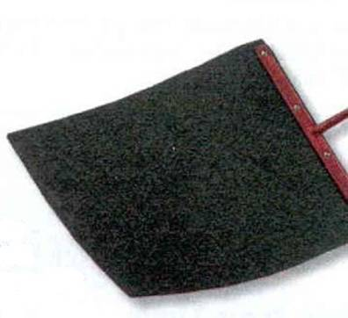
Fire Swatter
A hand tool used in fire suppression. The swatting action removes the available oxygen from the fire.

Slide 44
Dot Grid
Used in timber cruises and land measurement to determine area.

Slide 45
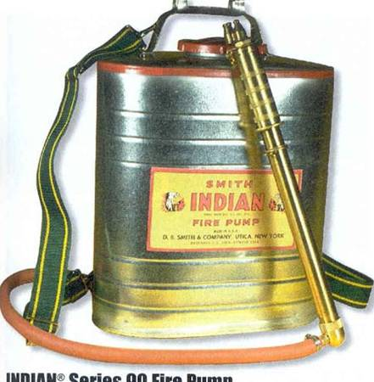
Back-pack Fire Pump
Fire suppression water pump, useful for controlling small fires.

Slide 46
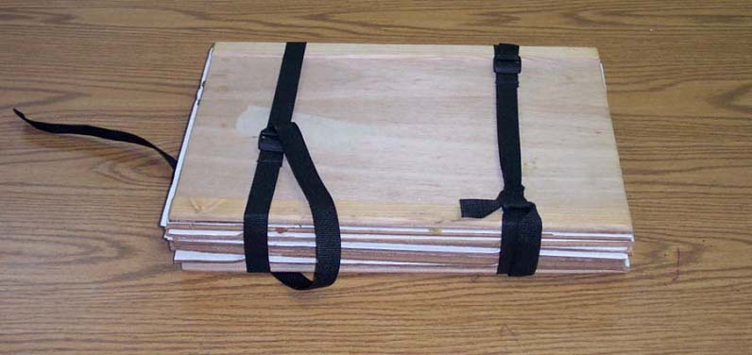
Plant Press
Used to press plants so that quality herbarium samples can be made. Plants are pressed flat so that they are easily attached to pages. Moisture is removed during the process so that leaves to not deteriorate.

Slide 47
Current Meter
Used to measure water velocity in creeks, streams, etc.

Slide 48
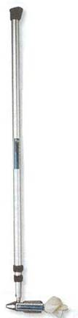
Flow Meter
Used to measure water velocity in areas such as storm runoff areas, streams, rivers, and partially filled pipes.

Slide 49
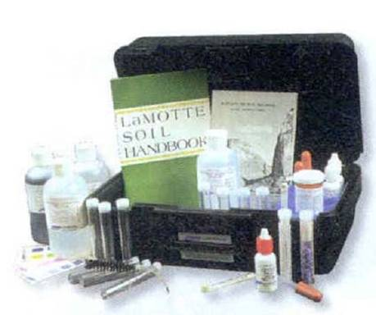
Soil Test Kit
A test kit designed soil analysis. Most kits include tests for pH, phosphorous, potassium, and nitrogen

Slide 50
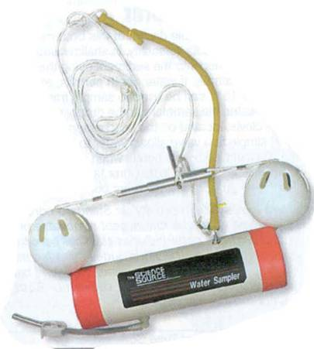
Water Sampler
Useful in collecting water samples from specific depths.

Slide 51
Densiometer
A useful tool for quickly estimating canopy coverage in a timber stand.

Slide 52
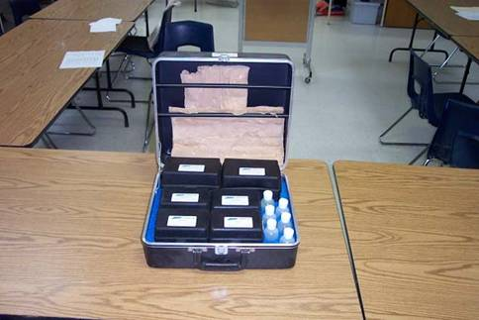
Water Test Kit
These test kits can contain various tests.
Most include tests for nitrates, nitrites, pH, and ammonia.

Slide 53
pH Meter
Used to determine the pH of water or soil

Slide 54
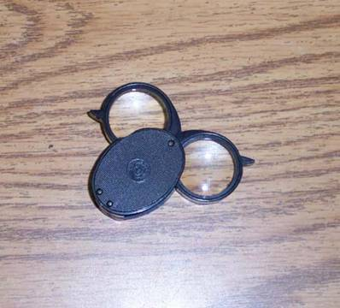
Hand Lens
Useful for examining small objects such as insects or flower parts.

Slide 55
The End

